Slide 1
Deep Learning of Humor from Gary Larson’s Cartoons
Robert Fischer, BSc.
TU Wien, Austria

Slide 2
Contents
Gary Larson and his cartoons
Aim
Computational Humor
Dataset
Approaches
Implementation
Results
Reproducibility

Slide 3
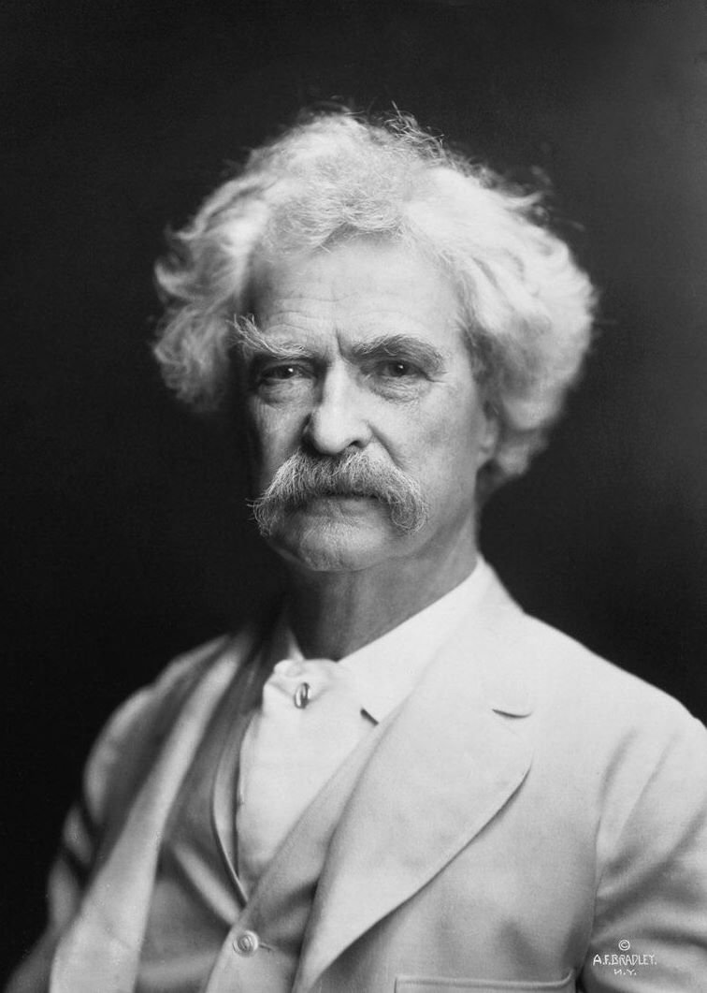
Humor
“Explaining humor is a lot like dissecting a frog, you learn a lot in the process, but in the end you kill it.”
– Mark Twain
Notes:
November 30, 1835 – April 21, 1910

Slide 4
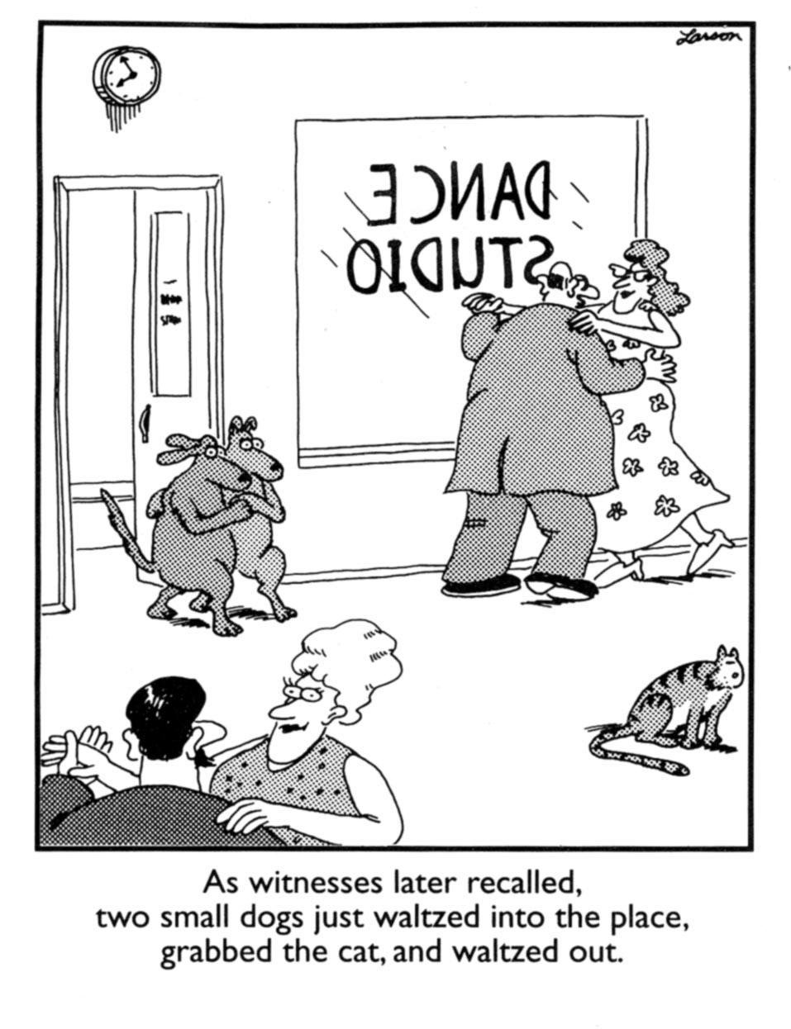
Gary Larson‘s Cartoons
Gary Larson‘s cartoons usually consist of a …
… single image depicting a funny situation
… punchline (~1-2 sentences)

Slide 5
Gary Larson‘s Cartoons
Distinct humor with several reoccuring themes
E.g.: Cats versus dogs

Slide 6
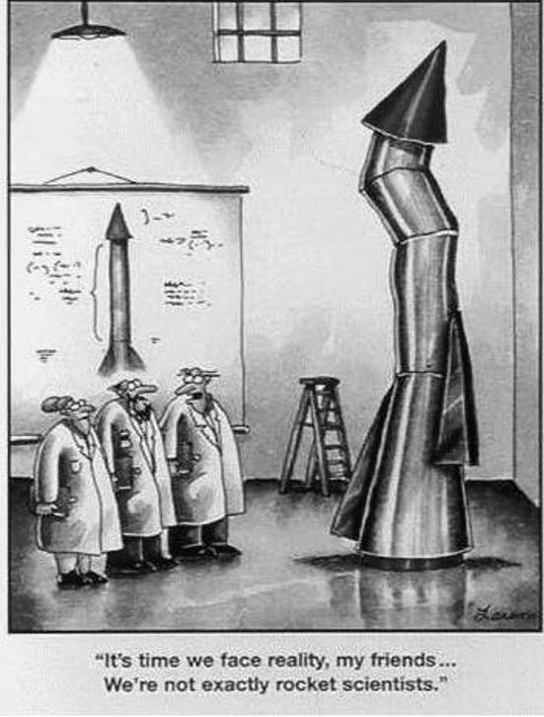
Gary Larson‘s Cartoons
Or scientists behaving childish

Slide 7
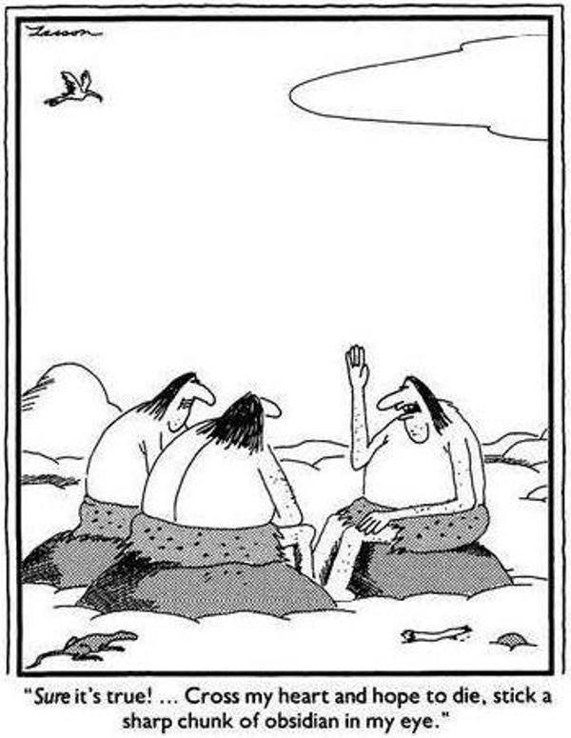
Gary Larson‘s Cartoons
Or stone age subverting our expectation

Slide 8
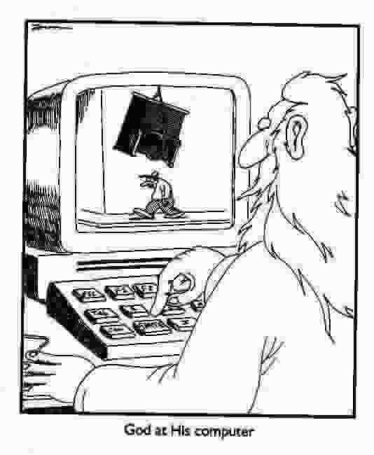
Aim
Different people find different cartoons funny.
Train a deep learning model which encapsulates the subjectivity of humor.
Gary Larson cartoons have each a similar structure and style, which makes them well suited data to learn from.

Slide 9
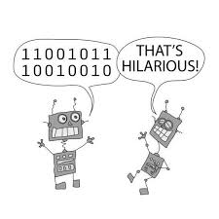
Computational Humor
Computational humor (=CH) combines the field of artificial intelligence with the research of humor [1].
Make computers understand humor.

Slide 10
Computational Humor
Generative computational humor: E.g.: Synthesizes jokes or puns.
Discriminative computational humor:
E.g.: Detect whether a sentence is funny or not.

Slide 11
Computational Humor
Trained on a large dataset with some form of funny and not funny annotation.
Large?
Notes:
Large is a problem, as a single person cannot annotate a large dataset

Slide 12
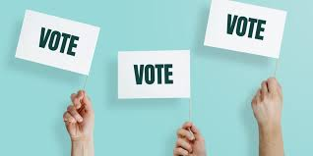
Computational Humor
Problem: These datasets are aggregated over multiple people, which loses the subjective aspect of humor [3].
The resulting models learn what people generally find funny.

Slide 13
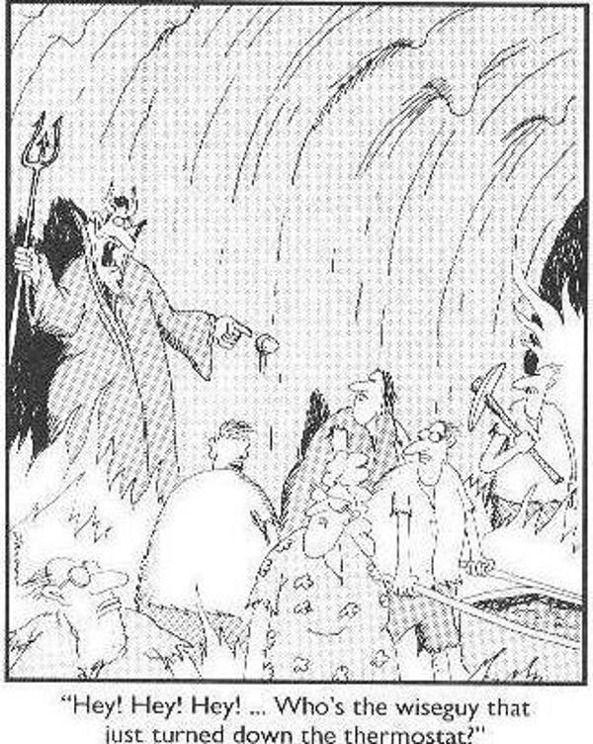
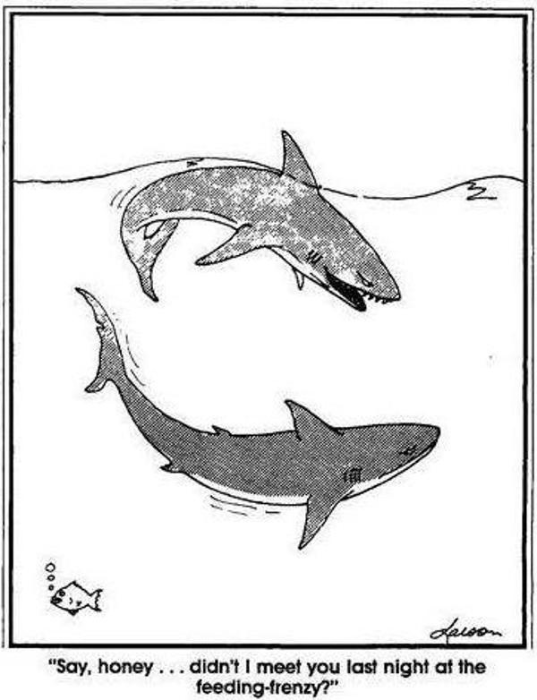
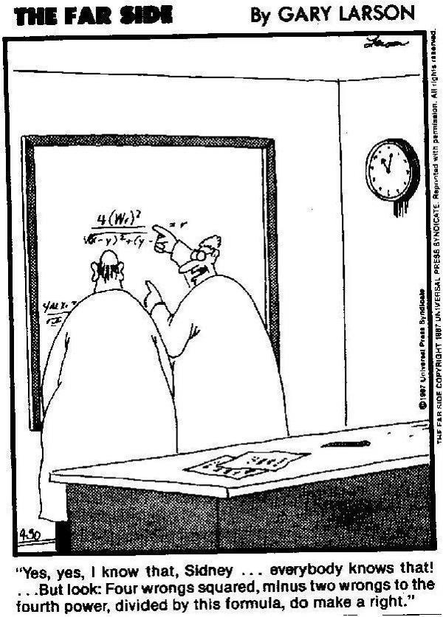
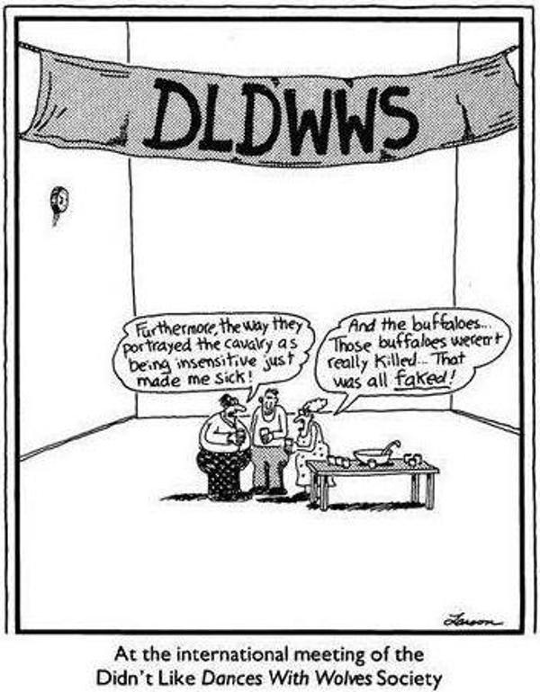
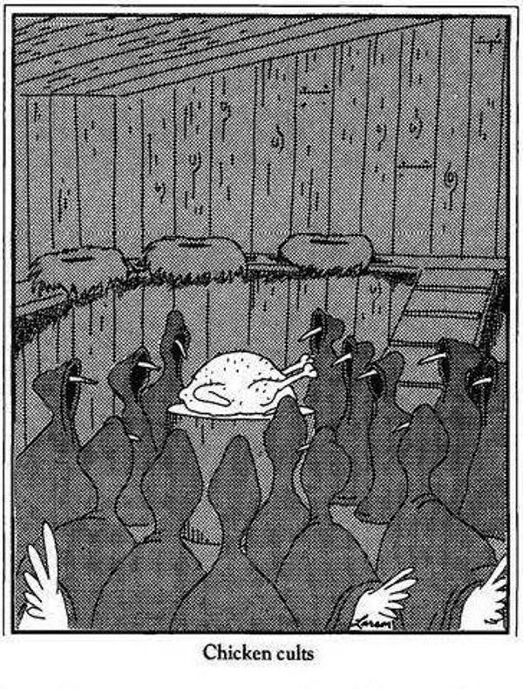
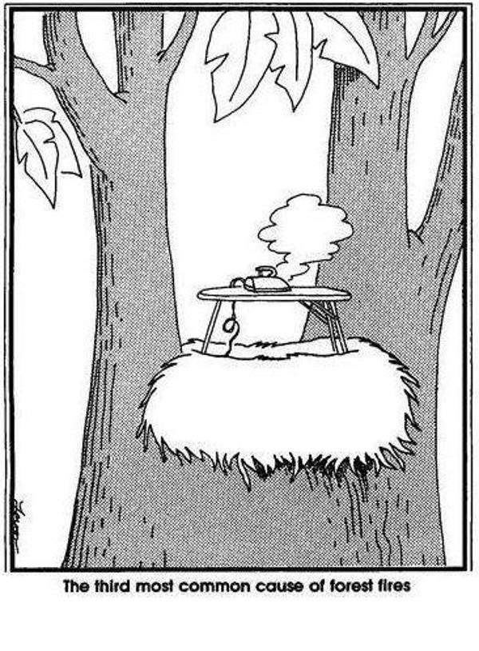
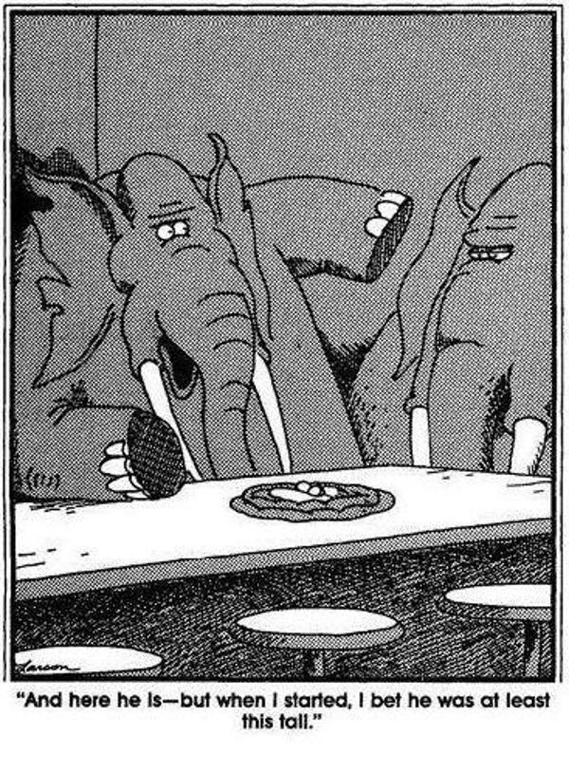
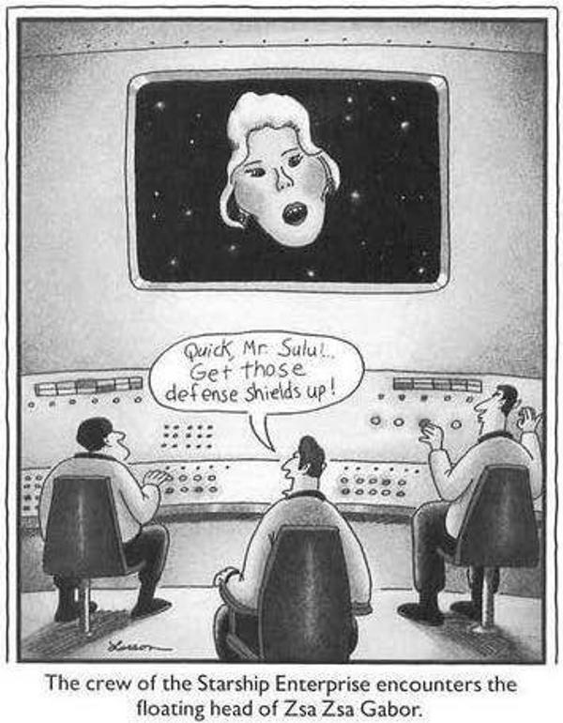
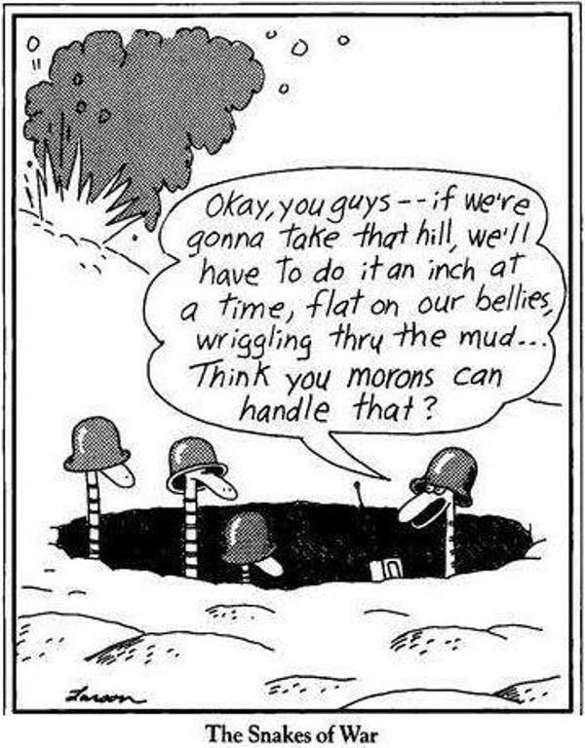
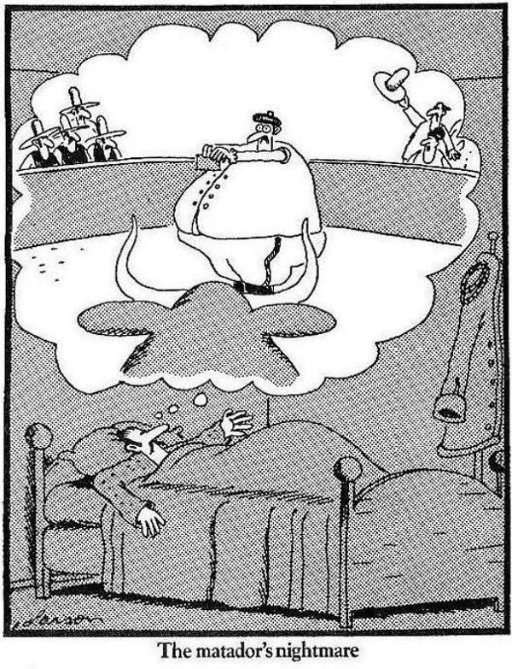
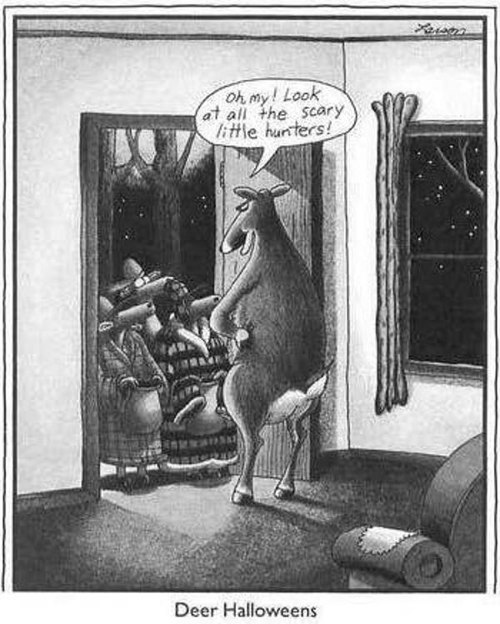
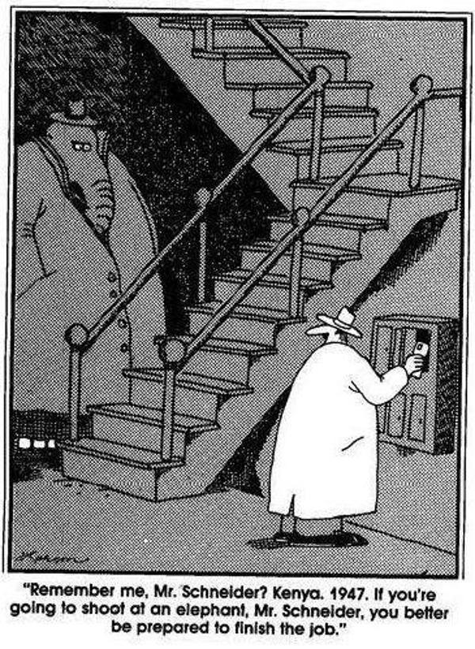
Dataset
There is no humor dataset annotated by a single person.
Novel Gary Larson dataset

Slide 14
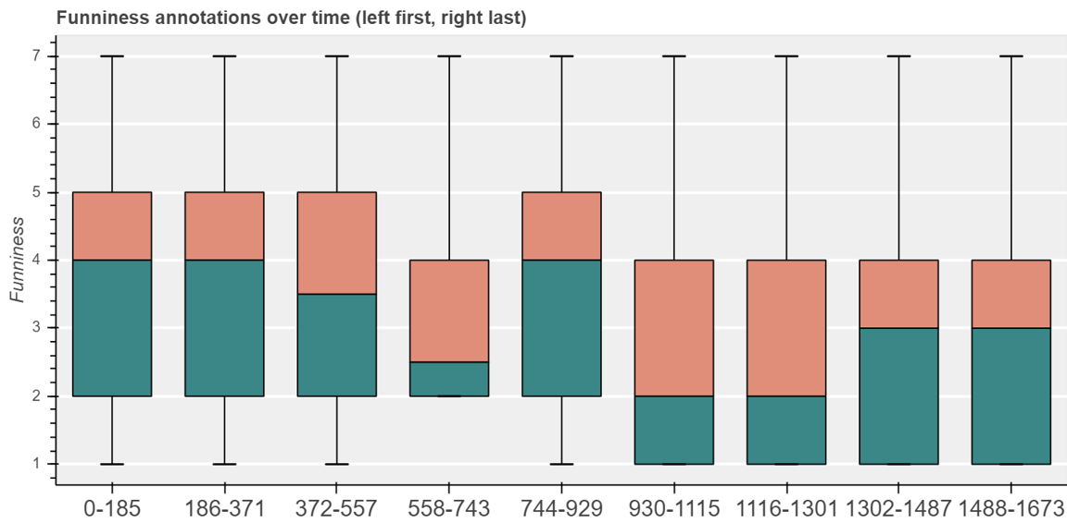
Dataset
Gary Larson dataset
2487 cartoons with ordinal funniness annotation
1 (not funny) to 7 (hilarious)
Annotated by myself
humor fatigue

Slide 15
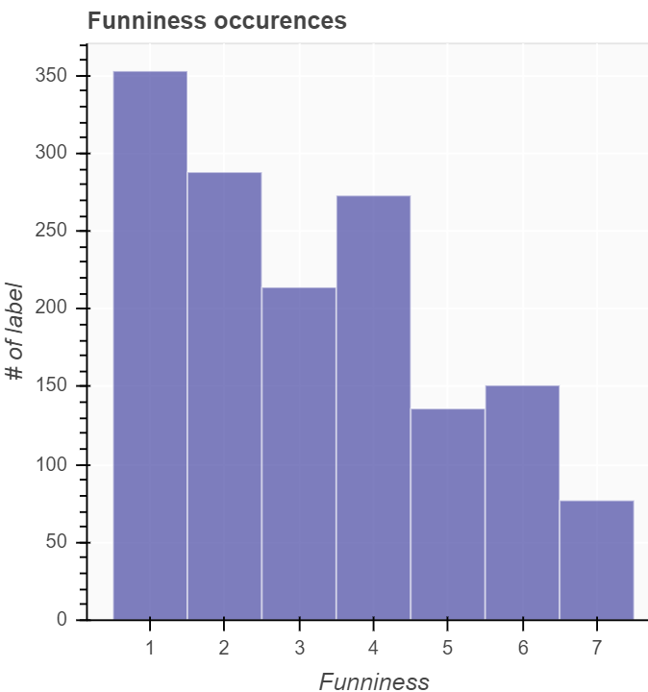
Dataset
Gary Larson dataset
OCR for the punchlines and additional manual adjustments
Custom written annotation application
Data analysis motivated further model development
Notes:
Manual adjustments:
fix typos
Correct orientation of images
Filtered bad examples and duplicates

Slide 16
Approaches
Three different approaches
Visual only: Model based on cartoons
Text only: Model based on punchlines
Visual and Text: Model based on both cartoons and punchlines

Slide 17
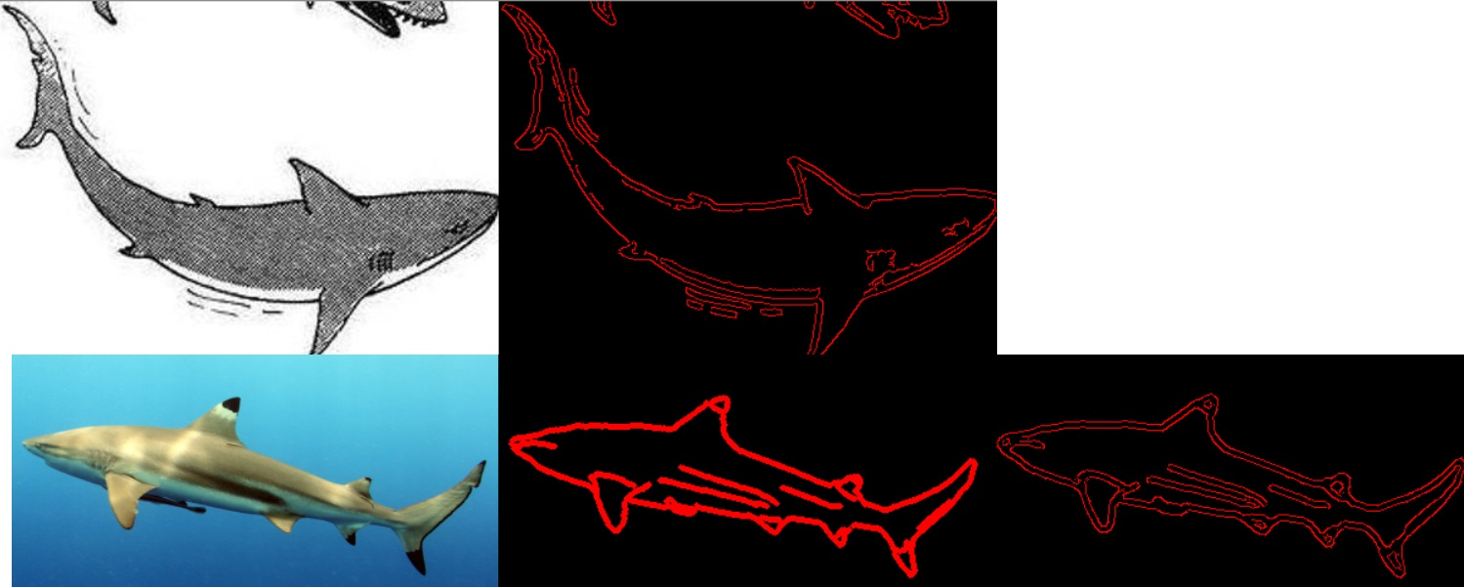
Approaches – Visual only
Convolutional Neural Networks [4]
Transfer Learning CNN
Transfer Learning Object Detection
Notes:
CNN: Many different hyperparameter configurations, deep shallow, learning rate, regularization, batch size etc.
Transfer Learning: Issue with different domain being trained from (real world images vs. cartoon images); Data Augmentation (random resize, rotation, color adjustments, etc.)
Transfer Learning Obj Det: Train object detection algorithm which returns a list of detected objects and use this feature vector for shallow classifier
Issue: We do not have such an object dataset. Existing datasets (Google Quick, Draq! And TU Berlin sketch not sufficient); Applying custom “cartoonize” operator did not work as well

Slide 18
Approaches – Text only
Word Embeddings
GloVE [7]
TF-IDF
ELMo [6]
LSTM / GRU architectures [5]
Automated Machine Learning
Sentence embedding
<punchline>
ELMo embedding
LSTM encoding
Fully Connected
Fully Connected
<prediction>
Notes:
GloVE = Global Vectors for Word Representation
ELMo = Embeddings from Languages Models
Sentence Embedding: Take only nouns and average the word embeddings
Take only nouns (as contain most semantic information)

Slide 19
Approaches – Visual and Text
Cascade multiple separately trained classifiers into final regressor
<punchline>
<cartoon>
Autoencoder
ELMo + GloVE sentence embedding
5x5 conv
Fully connected
3x3 conv
Fully Connected
Fully connected
Feature Extractor
<returns whether input
is in given class>
Fully connected
Notes:
Try to combat class imbalance, low number of training samples and easy combination of text and visual information
Ease use of oversampling
Keep actually trained parts shallow => no vanishing gradient
Fully Connected = FCN + BatchNorm + MaxPool

Slide 20
Approaches – Visual and Text
<punchline>
<cartoon>
Feature extractor
funniness 1
Feature extractor
funniness 2
Feature extractor
funniness 7
…
Fully connected
Fully connected
<funniness 1-7>
Notes:
Full pipeline (after first feature extractors trained)

Slide 21
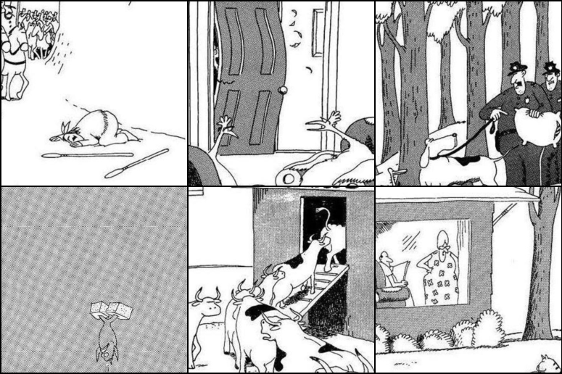
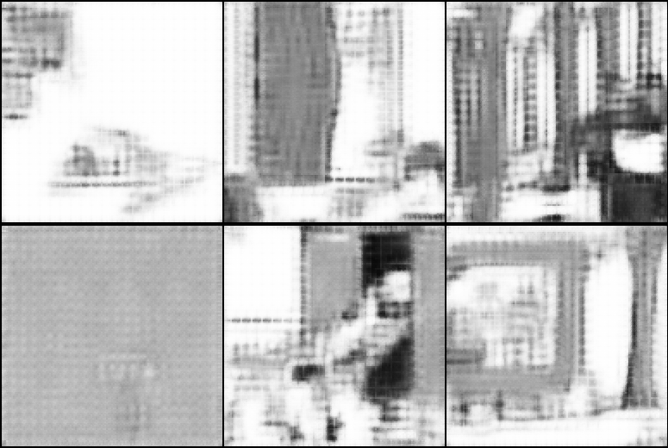
Approaches – Visual and Text
Convolutional Autoencoder [4]
Notes:
* Convolutional Autoencoder with

Slide 22
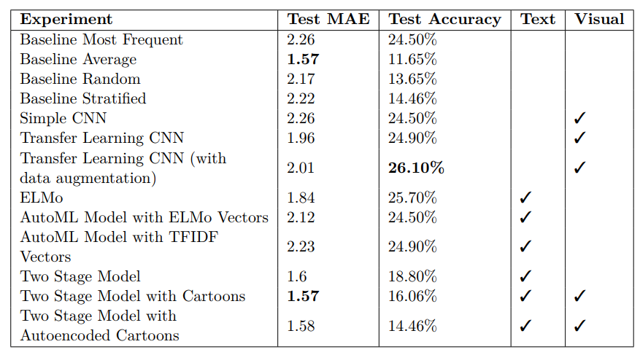
Results
Notes:
* Baselines best at Mean absolute error, accuracy is transfer learning best

Slide 23
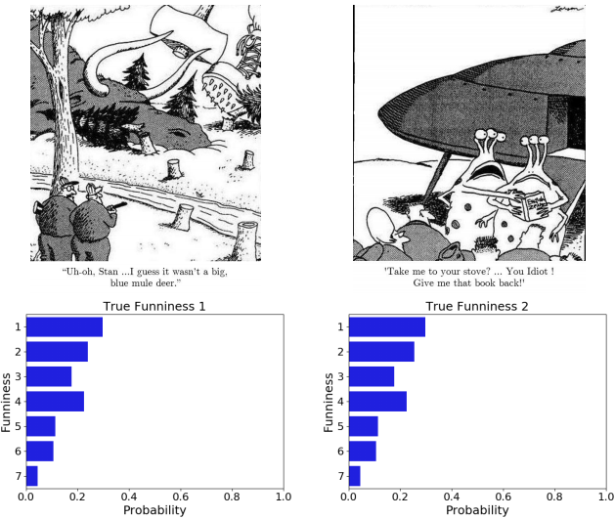
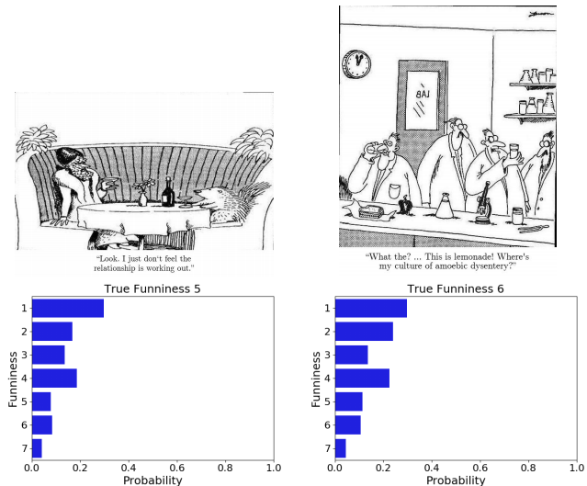
Results
Notes:
Key takeaway: Model learned the label distribution instead of any useful information

Slide 24

Results
Looks very similar to:
Notes:
Key takeaway: Model learned the label distribution instead of any useful information

Slide 25
Results
"A semantic gap is the difference in meaning between constructs formed within different representation systems.” [2]
Feature representation does not close the semantic gap for subjective humor
Models do not understand humor
Notes:
A representation system can be e.g. a natural language, a formal language or a proper language within an engineering domain”
Close semantic gap requires new advances in deep learning, or different problem setup:
Less categories to choose from
Transfer Learning more robust
No direct annotation, instead read brain activity directly

Slide 26
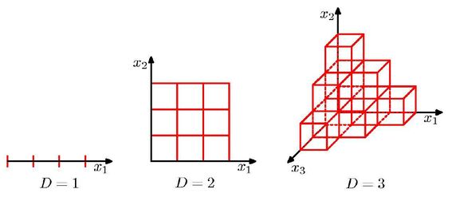
Results
Dataset most likely too small.
Curse of dimensionality [4]
Chosen dimensionality reduction measures insufficient
[8]
Notes:
Training Set: 1492 samples (60%)
Validation Set: 746 samples (30%)
Test Set: 249 samples (10%)
The more parameters a model has (more degrees of freedom), the more data are usually required to train such models. This is why most successful deep learning models are trained on huge datasets, as it is not uncommon for a deep learning model to have several million parameters
Dimensionality reduction through: Word Embeddings (ELMo, Glove, TFIDF, Autoencoder, Convolutional neural networks)
Curse of dimensionality

Slide 27
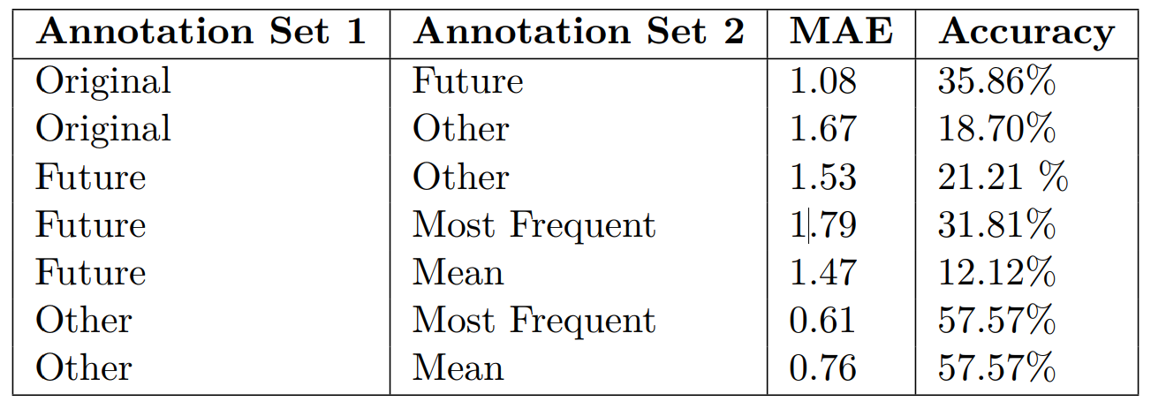
Reproducibility
Two new datasets:
Future: From myself, annotated 1 year later after initial annotation
Other: From Prof. Eidenberger
Notes:
Is it even possible for a human to reproduce his/her annotations?
Is humor actually subjective?
Subset with 200 samples
Humor is indeed reproducibile and subjective

Slide 28
Sources
Several cartoons by Gary Larson
[1] G. Ritchie. Current directions in computational humour 2001
[2] A. M. Hein. Identification and bridging of semantic gaps in the context of multidomain engineering 2010
[3] P.-Y. Chen and V.-W. Soo. Humor recognition using deep learning 2018
[4] I. Goodfellow, Y. Bengio, and A. Courville. Deep Learning 2016
[5] S. Hochreiter and J. Schmidhuber. Long short-term memory 1997
[6] M. E. Peters, M. Neumann, M. Iyyer, M. Gardner, C. Clark, K. Lee, and L. Zettlemoyer. Deep contextualized word representations 2018
[7] J. Pennington, R. Socher, and C. D. Manning. Glove: Global vectors for word representation 2014
[8] https://www.researchgate.net/figure/Illustration-of-the-Curse-of-dimensionality-showing-how-the-number-of-regions-of-a_fig9_278786166

Slide 29
Thank You for your Attention!
Please feel free to ask any further questions!

Slide 30






Implementation
Python
PyTorch
pandas
NumPy
scikit-learn
hyperopt-sklearn
AllenNLP
django

Slide 31
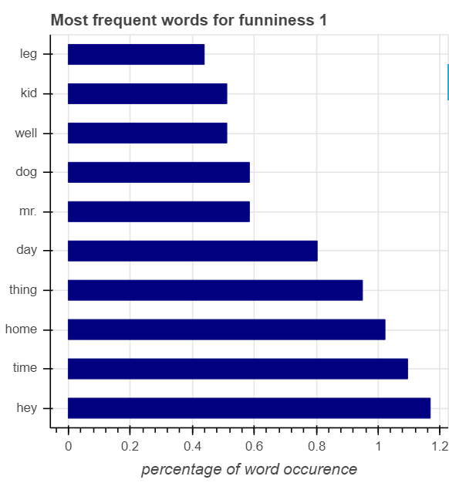
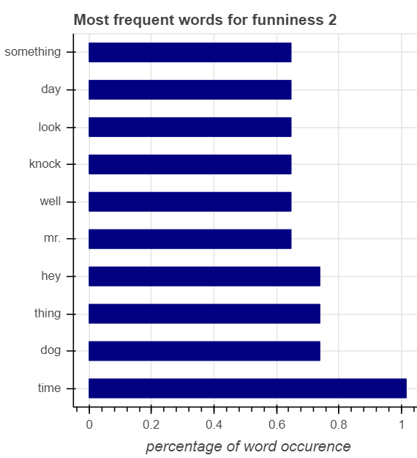
Data Analysis

Slide 32
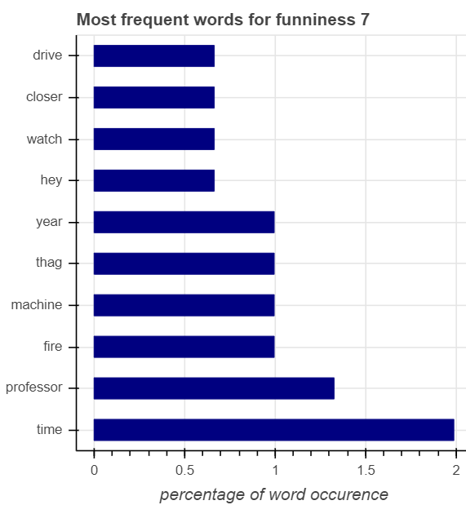
Data Analysis

